Slide 1

CSE 470/598 Illumination Models
Ross Maciejewski
rmacieje@asu.edu

Slide 2
Disclaimer
These slides can only be used as study material for the class 470 at ASU
The slides cannot be distributed or used for another purpose

Slide 3
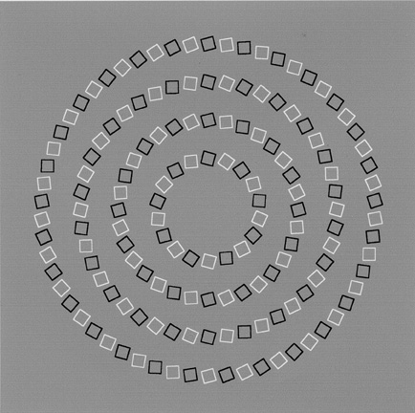

Slide 4
Overview
Modeling the interaction of light with surfaces to determine the final color & brightness of the surface
Global illumination models
Local illumination models

Slide 5
Global illumination models
Interaction of light from all the surfaces in the scene
Examples
Kajiya's rendering equation
Recursive ray-tracing

Slide 6
Local illumination models
The lights, the observer position, and the object characteristics determine its final brightness and color

Slide 7
Local illumination models
Light Source Characteristics
Color, Intensity, Direction, Angle of illumination, geometry
Material Characteristics
Reflection properties, color, transparency, refraction, micro-surface geometry
Types of Light
Ambient, Diffuse, Specular

Slide 8
Ambient light
Definition
The light that is the result from the light reflecting off other surfaces in the environment that strikes all the surfaces in the scene from all directions
This is independent of direction
The equation for the amount of light received by a surface is
I = I_{a}k_{a}
I_{a} is the intensity of the ambient light in the scene
k_{a} is the ambient-reflection coefficient which determines the amount of ambient light reflected from a given surface. 0 <= k_{a} <= 1

Slide 9
Diffuse Light
Definition
The direct illumination that an object receives from a light source that it reflects equally in all directions
Dull surfaces exhibit diffuse reflection
Also called Lambertian Reflection from Lambert's Law
Brightness of object is independent of observer position
Reflect equally in all directions

Slide 10
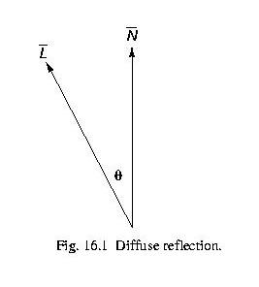
Diffuse Light
Lambert's Law
I_{d} = I_{p} cos(θ)
where I_{p} is the point light source's intensity
I_{d} = I_{p} k_{d} (N · L)
if N & L are normalized, 0 <= k <= 1
Combined with ambient light,
I = I_{a}k_{a} + I_{p}k_{d} (N · L)

Slide 11
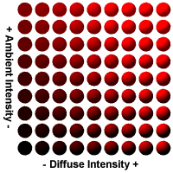
Effect of Ambient and Diffuse

Slide 12
Specular Reflection
Bright spots on objects (hot spots)
If you look around, these move as you move around
Specular reflection is dependent on the observer position

Slide 13
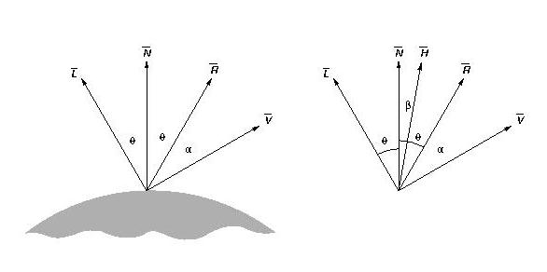
Specular Reflection
The half-angle vector (H = L+V, normalized) – Blinn-Phong formulation
The direction of maximum highlights
If the normal is aligned with H, you will have maximum highlights. As you move away from this, it will decrease.

Slide 14
Specular Reflection
Phong's model (or Blinn-Phong model)
I_{s} = k_{s}(N · H)^{n}
0 <= k_{s} <= 1, property of the material
n >= 1, Good choice is 50

Slide 15
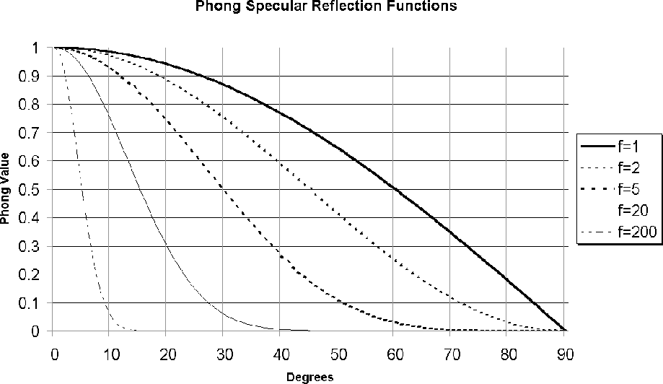
Effect of Specular Exponent

Slide 16
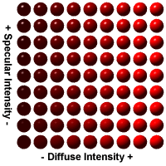
Effect of Diffuse and Specular

Slide 17
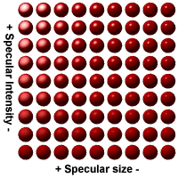
Effect of Specular Exponent

Slide 18
Final Illumination Model
I = I_{a}k_{a} + I_{p}k_{d} (N · L) + k_{s}(N · H)^{n}

Slide 19
Implementation of Illumination Models – Production Trick
Ambient:
Assume I_{a} is 1, choose k_{a} to be between .15 and .3
Diffuse:
Normally, choose k_{d} = 1 - k_{a}, I often use k_{a} = .2 and k_{d} = .8

Slide 20
Implementation of Illumination Models – Production Trick
Specular:
Don't want to wash everything out with specular (r, g, b > 1).
Don't want a specular highlight if light behind face (N * H could still be greater than 0)
Solutions
To avoid colors > 1.0
d_{a} = I_{a}k_{a} + l_{p}k_{d} ( N · L)
I = d_{a} + (1-d_{a})I_{p}k_{s} ( N · L)^{n}
Add specular only if N · L > 0
For nice highlights, use ks = 1.0 & 10 <= n < 100 (50 is good)

Slide 21
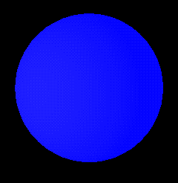
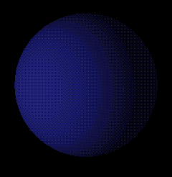
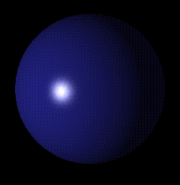
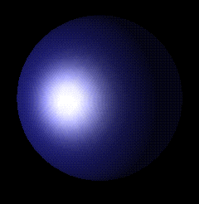
Review of the Components
Ambient Diffuse Specular
n small n large

Slide 22
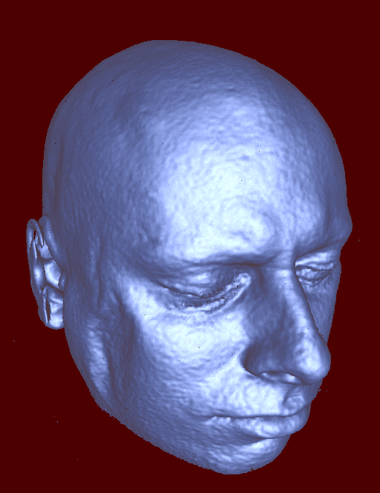
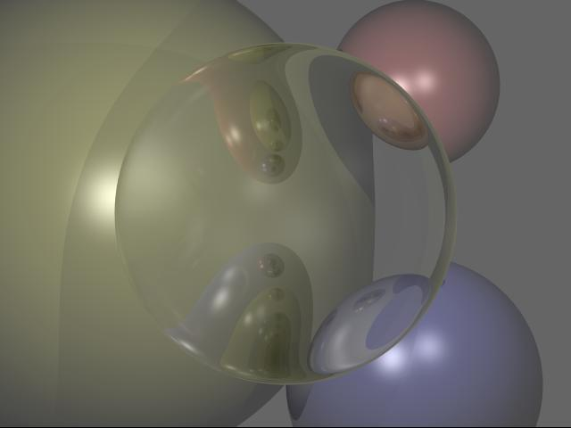
More Specular Examples

Slide 23
Implementing Phong Specular Illumination
Formula for intensity
d_{a} =I_{a}k_{a} + I_{p}k_{d} (N · L )
I = d_{a} + (1 - d_{a}) I_{p}k_{s} (N · H)^{n}
Add specular if N · L > 0 and N · H > 0

Slide 24
Implementing Phong Specular Illumination
Object color and illumination
Add color into this intensity calculation
The diffuse and ambient intensity is multiplied by the color of the object
Specular illumination is affected by the color of the light, not the object in the simple model
The color of the light actually affects all components

Slide 25
Implementing Phong Specular Illumination
Object color and illumination
n_l = (N · L)
if (n_l > =0.0)
da = obj_amb[obj] + obj_kd[obj]*n_l
else
da = obj_amb[obj]
d_a.r = da*obj_color[obj].r,
d_a.g = da*obj_color[obj].g,
d_a.b = da*obj_color[obj].b
spec.r=spec.g=spec.b=0;
if (n_l > 0) {
n_h = pow(MAX(0, (N · H)), obj_specexp[obj])
spec.r = obj_ks[obj]*n_h,
spec.g = obj_ks[obj]*n_h,
spec.b = obj_ks[obj]*n_h
}
final_color.r = MIN(1.0, (d_a.r + (1-d_a.r)*spec.r))
final_color.g = MIN(1.0, (d_a.g + (1-d_a.g)*spec.g))
final_color.b = MIN(1.0, (d_a.b + (1-d_a.b)*spec.b))

Slide 26
Implementing Phong Specular Illumination
Faceted Shading
Create a structure to hold the user selected color of each object (obj_color[obj])
Create a structure to hold the final color after illumination of each polygon (face_color[obj][face] ) Set face_color[obj][face]= final_color

Slide 27



Implementing Phong Specular Illumination
Examples of illumination types
Ambient Illumination
Diffuse plus Ambient
Illumination
Specular plus Diffuse plus Ambient Illumination

Slide 28
Lights and Illumination
Colored Lights
The previous formulas assumed that we had white light
The color of the light source will of course affect the color of light reflected from a surface
Remember, the color of an object is a function of the incident wavelengths of light that it reflects

Slide 29
Lights and Illumination
Illumination with colored lights
To add colored lights to our illumination model, we simply need to multiply each illumination component by the color of the light
Diffuse and Ambient with colored lights
if (N · L) > 0
d_a.r = ka* object_color.r + kd(N · L) * object_color.r * light_color.r
d_a.g = ka* object_color.g + kd(N · L) * object_color.g * light_color.g
d_a.b = ka* object_color.b + kd(N · L) * object_color.b * light_color.b

Slide 30
Lights and Illumination
Illumination with colored lights
Specular Illumination with colored lights
For our specular illumination, the color of the highlight will now be the color of the light, so the formula gets changed as follows
if (N · L > 0) {
n_h = (MAX(0, (N · H) )spec_exp
spec.r = obj_ks[obj]*n_h * light_color.r;
spec.g = obj_ks[obj]*n_h * light_color.g;
spec.b = obj_ks[obj]*n_h * light_color.b;
}
final_color.r = MIN(1.0, (d_a.r + (light_color.r - d_a.r)*spec.r))
final_color.g = MIN(1.0, (d_a.g + (light_color.g - d_a.g)*spec.g))
final_color.b = MIN(1.0, (d_a.b + (light_color.b - d_a.b)*spec.b))

Slide 31
Lights and Illumination
Multiple Lights
Multiple lights are very easy to implement
All you need to do is to add the illumination from each light source, making sure that you do not allow the final color values to exceed 1.0

Slide 32
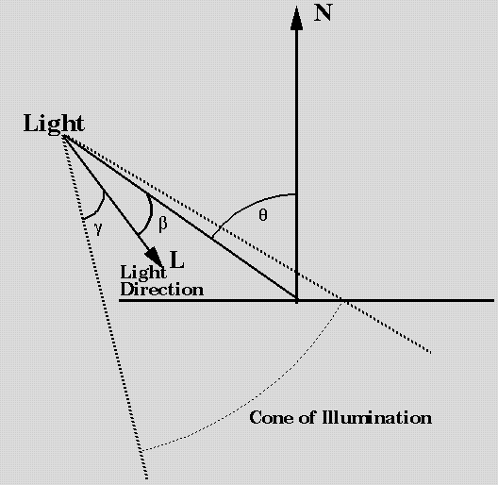
Lights and Illumination
Other Light Effects
Directions lights
Add a light center of interest for each light source
Create the light direction vector as (light_coi - light_position)
Calculate the angle, beta, between the light direction vector and the vector from the light to the point being rendered
Create a falloff of the light source using cos(β)^{n}

Slide 33
Lights and Illumination
Other Light Effects
Angle limited lights
Add a angle of illumination of each light and check to see if the the point being rendered is within this angular area
if ( cos(γ) > cos(β) )
light_intensity = light_intensity * cos^{n}(β)
else
light_intensity=0

Slide 34




Lights and Illumination
Examples of Lighting Effects
Single White Light Light
Single Red Light Source
Red Light Source plus a Blue Light Source
Red Light Source, Green Light Source Blue Light Source

Slide 35




Lights and Illumination
Nomal Illumination
Angular Fall-Off with exponent = 800
Angular Cut-off (spotlight)
4 light sources of different
colors and fall-offs

Slide 36
Advanced Illumination
Illumination review
Ambient -- approximate global illumination effects
Diffuse -- Lambert's Law -- absorbed and reradiated equally in all directions (depend on wavelength, independent of observer)
Specular -- reflects off surface => color of light in many cases is color of object

Slide 37
Advanced Illumination
Definitions
Flux -- rate at which energy is emitted (Watts)
Solid angle -- angle at the apex of a cone. It is measured in terms of the area on a sphere intercepted by a cone whose apex is at the sphere's center
Steradian (sr) -- solid angle of a cone that intercepts an area equal to square of the sphere's radius r. Hemisphere has sr
Radiant intensity -- flux per unit solid angle in a given direction
Radiance -- radiant intensity per unit foreshortened surface area. (W / sr * m²)

Slide 38
Advanced Illumination
Definitions
Foreshortened surface area -- projected surface area → projection of surface onto the plane perpendicular to the direction of radiation. It equals to where is the angle between radiation and surface normal
Irradiance -- the incident flux per (unforeshortened) unit surface area
Irradiance of incidence light -- where is incident radiance
Bidirectional reflectivity --

Slide 39
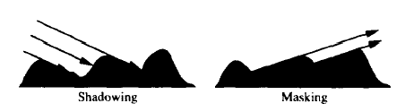
Advanced Illumination
Cook-Torrance use
D is distribution function of microfacet orientations
G is geometrical attenuation factor -- masking and shadowing effects of the microfacets on each other
is the Fresnel term
Blinn's model

Slide 40
Advanced Specular Illumination Models
3 Main components:
Microfacet model
Roughness term
Fresnel term

Slide 41
Advanced Specular Illumination Models: Microfacet Mode
Microfacet model:
Surface composed of many small V-shaped mirror, lined with mirrors
Randomly oriented sea of these grooves
Specular – single reflection off these mirrors
Diffuse – multiple microfacet reflection and interaction with substrate material
Shadowing - groove walls can block incoming light
Masking – groove reflected light blocked on its way out

Slide 42
Advanced Specular Illumination Models: Roughness Term
Characterizes the distribution of microfacets
D is the facet slope distribution function
Different choices (Gaussian, Beckman, etc.)

Slide 43
Advanced Specular Illumination Models: Fresnel Term
Amount of reflected and refracted light at an interface is a function of
Wavelength of incident light
Geometry of the surface
Angle of incidence
Effects summarized in Fresnel’s formulas

Slide 44
Advanced Illumination
Distribution Functions
Phong's model
Blinn
T-Sparrow
C-Torrance
where m is root mean square slope of microfacets (Beckman distribution)

Slide 45
Advanced Illumination
Shadowing and masking

Slide 46
Advanced Illumination
Fresnel Factor
where is angle of incidence relative to H , and n is index of refraction
In another form
where and

Slide 47
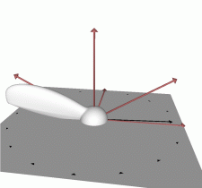
Cook-Torrance Illumination (continued)
Formula
where and

Slide 48
Cook-Torrance Illumination (continued)
Also can do it as
where red(0) is color of material at normal incidence. Then,
Hall suggested a similar method

Slide 49
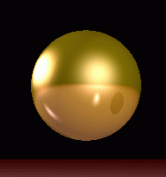

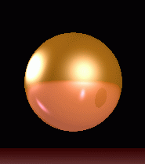
Cook-Torrance Result
Gold
Copper

Slide 50
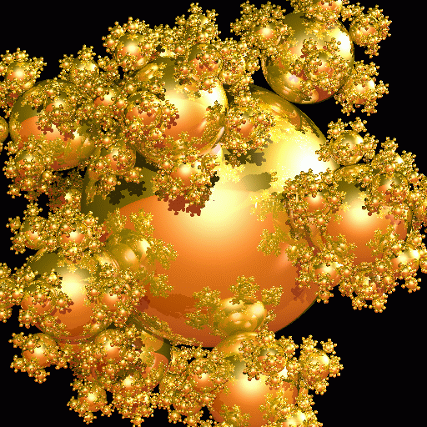
Cook-Torrance Result
Gold

Slide 51
Improved Diffuse Reflection
Oren and Nayar developed a surface roughness model for diffuse reflection similar to the Cook-Torrance model
Used for textured surfaces
What area was this research for?
Computer Vision

Slide 52
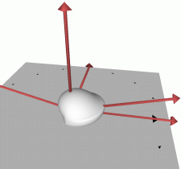
Oren – Nayar Diffuse Reflection
ρ/π is the radiance of a microfacet
E₀ is the directly illuminated irradiance

Slide 53
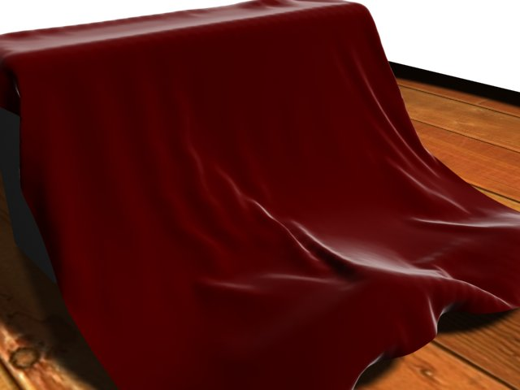
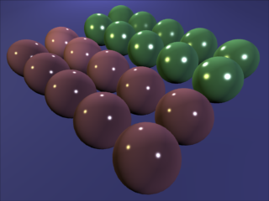
Oren Nayar Results

Slide 54
Global Illumination
Introduction
Global illumination must consider 4 types of light transport between pairs of surfaces
diffuse to diffuse
specular to diffuse -- handles caustics and refraction
diffuse to specular
specular to specular
All must be considered at once for each light propagation path

Slide 55
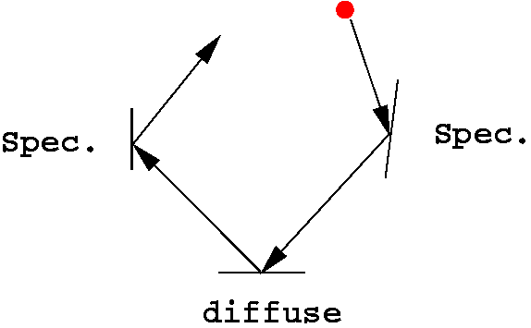
Global Illumination
Introduction
Post processing radiosity solution with ray-tracing won't work!
Why?
some specular may be result of earlier diffuse reflection
some diffuse may be re-reflected specular

Slide 56
Global Illumination
Radiosity does
diffuse to diffuse correctly
Ray tracing does
specular to specular correctly
diffuse to specular empirically
specular to diffuse can be added in by a 2 pass method:
Pass1 -- backward trace light from source to environment
Pass2 -- normal tracing using illumination from Pass1

Slide 57
Global Illumination
Combining Ray Tracing and Radiosity --Two pass method:
Pass1: Enhanced Radiosity - View Independent [Rushmerier 90]
handles:
diffuse – diffuse
specular-diffuse

Slide 58
Global Illumination
Pass1(cont)
General Equation
Diffuse transmission:
where is backward diffuse transmission
Specular transmission: path j may specularly transmit light-window form factor
Specular-diffuse reflection: mirror form factor add terms to handle seeing ``virtual'' through mirror surface
The last two items are only for specular surfaces that can't see each other

Slide 59
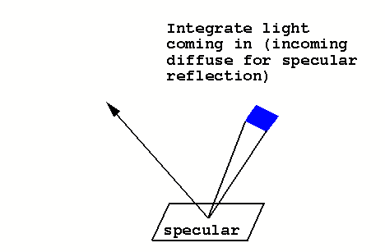
Global Illumination
Pass2: ``Enhanced Ray-Tracing'' -- View Dependent
Specular-specular -- normal ray tracing
Diffuse-specular
Integrate light arriving at reflection point by using a square pyramid in the direction of specular bump
Divide into grid and do a z-buffer at low resolution to see what is visible -- use radiosity calculated intensities here
can do recursively
Only handles special cases of specular transmission and specular-diffuse reflection

Slide 60
Global Illumination
Rendering Equation [Kajiya 1986]
= transport intensity (from x' to x)
= visibility between x and x'
= transfer emittance from x' to x
= scattering or bidirectional reflectivity -- intensity of light at x' from x''scattered in direction x
s means all points on all surfaces in the scene
Interpretation:
transport from x' to x = sum of light emitted from x' in direction of x plus the total light scattered from x' to x from all other surfaces

